Slide 1


CSE422 : ARTIFICIAL INTELLIGENCE
PROPERTIES OF ENVIRONMENT
BY
BENJIR ISLAM ALVEE

Slide 2
What is Environment?
An environment is everything in the world which surrounds the agent, but it is not a part of an agent itself.
An environment can be described as a situation in which an agent is present.

Slide 3
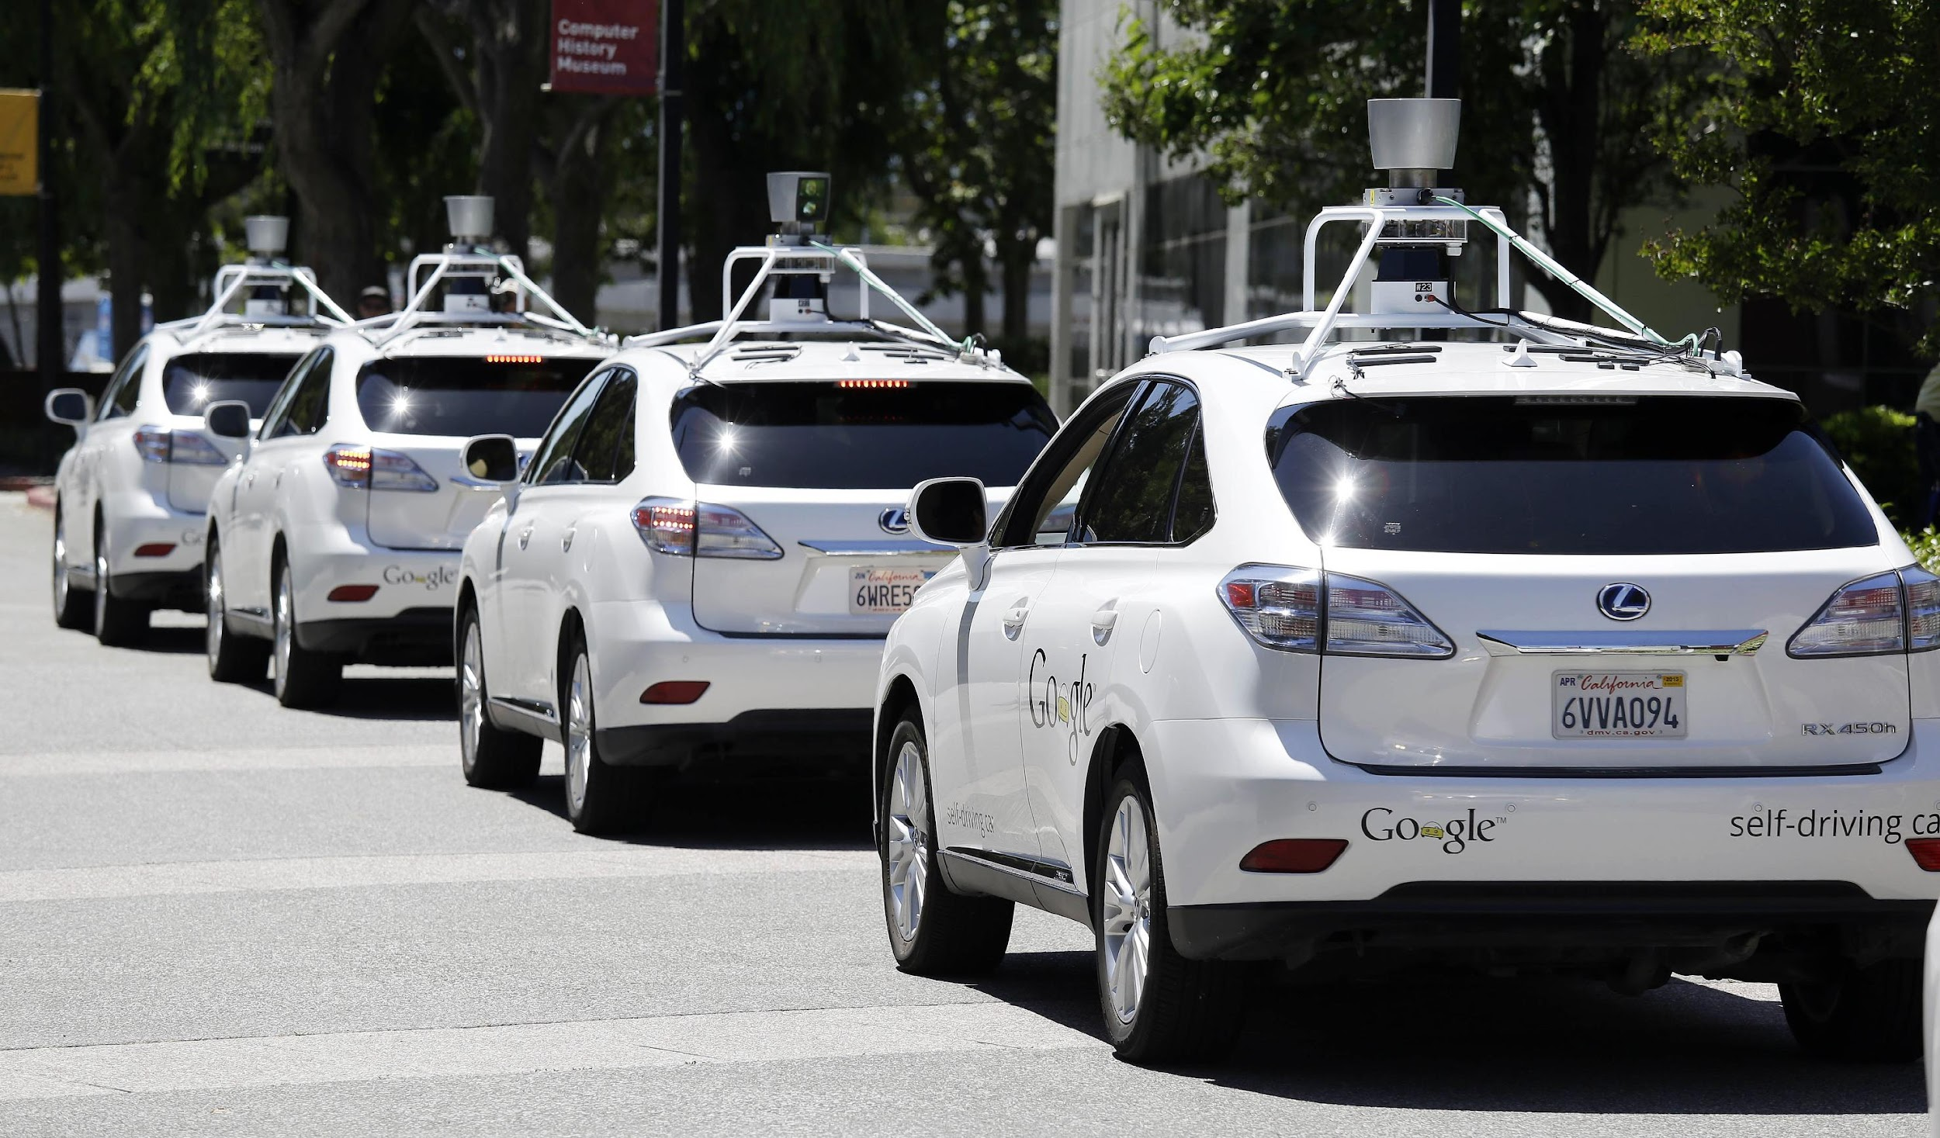
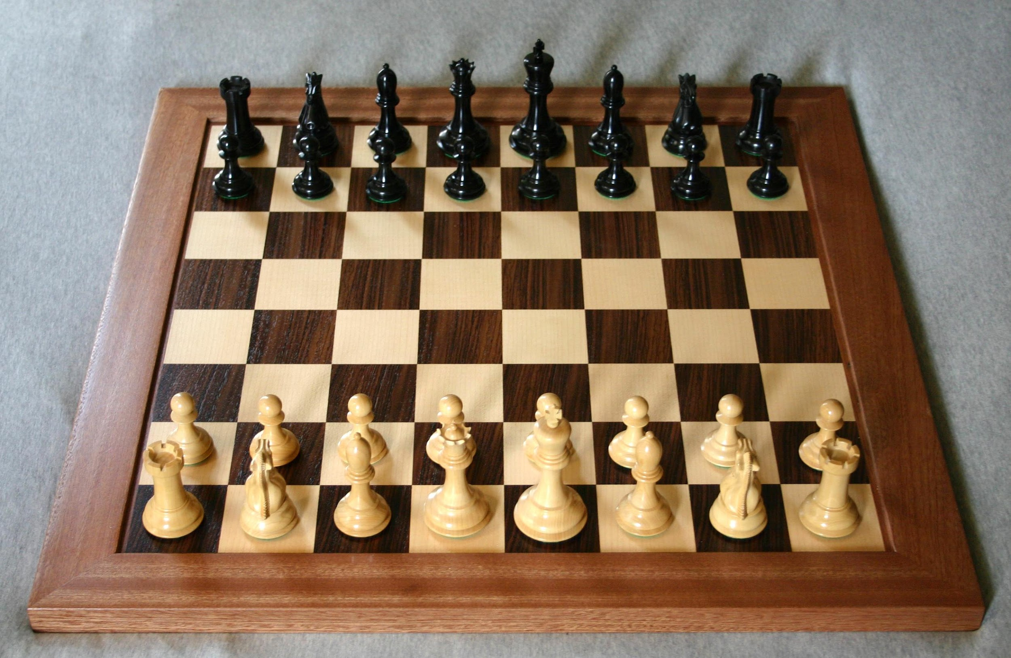

Fully observable/Partially observable
If an agent sensor can sense or access the complete state of an environment at each point of time then it is a fully observable environment, else it is partially observable.
Example: Tic-Tac-Toe, Chess(A player gets to see the whole board)
A fully observable environment is easy as there is no need to maintain the internal state to keep track history of the world.
An agent with no sensors in all environments then such an environment is called as unobservable.
Example: Automated taxi driving, Poker(A player gets to see only his own cards, not the cards of everyone in the game)

Slide 4
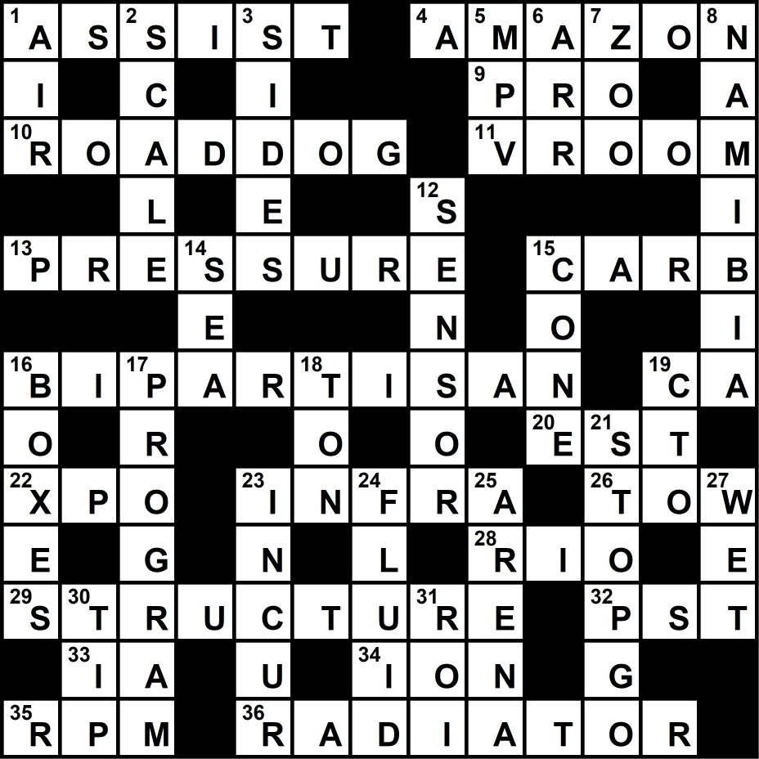
Single agent/Multi-agent
If only one agent is involved in an environment, and operating by itself then such an environment is called single agent environment.
However, if multiple agents are operating in an environment, then such an environment is called a multi-agent environment.
The agent design problems in the multi-agent environment are different from single agent environment
Example: Single agent(Crossword Puzzle), Multi-agent(Chess)

Slide 5
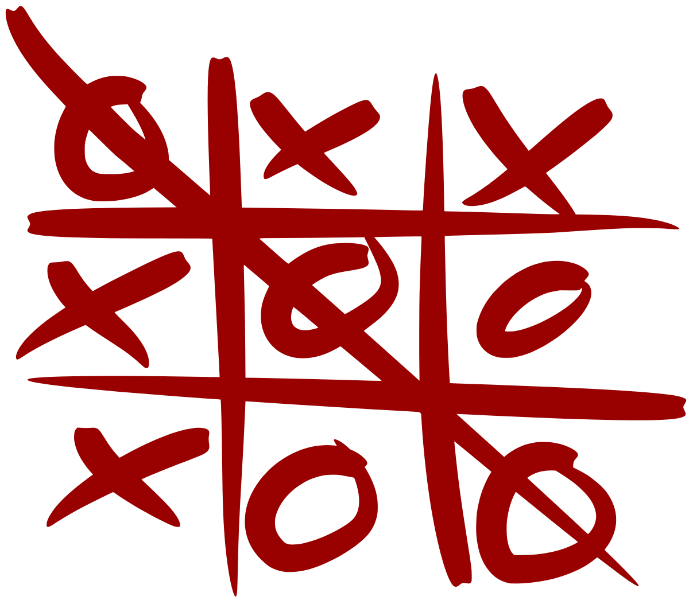
Deterministic/Stochastic
If an agent's current state and selected action can completely determine the next state of the environment, then such environment is called a deterministic environment.
A stochastic environment is random in nature and cannot be determined completely by an agent.
In a deterministic, fully observable environment, agent does not need to worry about uncertainty.
Example: Deterministic(Tic Tac Toe, Chess), Stochastic(Poker)

Slide 6
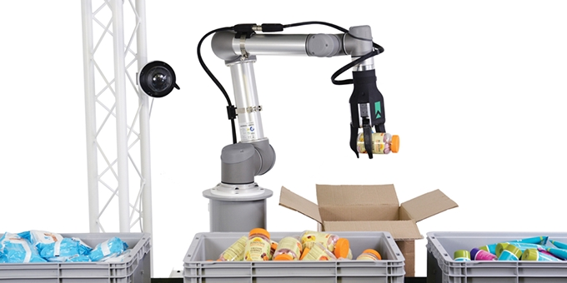
Episodic/Sequential
In an episodic environment, there is a series of one-shot actions, and only the current percept is required for the action.
However, in sequential environment, an agent requires memory of past actions to determine the next best actions.
Such environments do not require the agent to plan ahead.
Example: Episodic(Part Picking Robot, Vacuum cleaner), Sequential(Chess, Taxi Driving)

Slide 7
Static/Dynamic
If the environment can change itself while an agent is deliberating then such environment is called a dynamic environment else it is called a static environment.
Static environments are easy to deal because an agent does not need to continue looking at the world while deciding for an action.
However for dynamic environment, agents need to keep looking at the world at each action.
Example: Static(Crossword Puzzle), Dynamic(Taxi Driving)

Slide 8
Discrete/Continuous
If in an environment there are a finite number of percepts and actions that can be performed within it, then such an environment is called a discrete environment else it is called continuous environment.
Example: Discrete(Crossword Puzzle, Poker), Continuous(Taxi Driving)

Slide 9
Known/Unknown
Known and unknown are not actually a feature of an environment, but it is an agent's state of knowledge to perform an action.
In a known environment, the results for all actions are known to the agent. While in unknown environment, agent needs to learn how it works in order to perform an action.
It is quite possible that a known environment to be partially observable and an unknown environment to be fully observable.

Slide 10
Characteristics of environments
Task Environment | Fully observable? | Deterministic? | Episodic? | Static? | Discrete? | Single agent?
Crossword
Poker
Taxi driving
Image analysis
Medical diagnosis

Slide 11
Characteristics of environments
Task Environment | Fully observable? | Deterministic? | Episodic? | Static? | Discrete? | Single agent?
Crossword | YES | YES | NO | YES | YES | YES
Poker
Taxi driving
Image analysis
Medical diagnosis

Slide 12
Characteristics of environments
Task Environment | Fully observable? | Deterministic? | Episodic? | Static? | Discrete? | Single agent?
Crossword | YES | YES | NO | YES | YES | YES
Poker | NO | NO | NO | YES | YES | NO
Taxi driving
Image analysis
Medical diagnosis

Slide 13
Characteristics of environments
Task Environment | Fully observable? | Deterministic? | Episodic? | Static? | Discrete? | Single agent?
Crossword | YES | YES | NO | YES | YES | YES
Poker | NO | NO | NO | YES | YES | NO
Taxi driving | NO | NO | NO | NO | NO | NO
Image analysis
Medical diagnosis

Slide 14
Characteristics of environments
Task Environment | Fully observable? | Deterministic? | Episodic? | Static? | Discrete? | Single agent?
Crossword | YES | YES | NO | YES | YES | YES
Poker | NO | NO | NO | YES | YES | NO
Taxi driving | NO | NO | NO | NO | NO | NO
Image analysis | YES | YES | YES | SEMI | NO | YES
Medical diagnosis

Slide 15
Characteristics of environments
Task Environment | Fully observable? | Deterministic? | Episodic? | Static? | Discrete? | Single agent?
Crossword | YES | YES | NO | YES | YES | YES
Poker | NO | NO | NO | YES | YES | NO
Taxi driving | NO | NO | NO | NO | NO | NO
Image analysis | YES | YES | YES | SEMI | NO | YES
Medical diagnosis | NO | NO | NO | NO | NO | YES

Slide 16
The most challenging environments are partially observable, stochastic, sequential, dynamic, and continuous, and contain multiple intelligent agents

Slide 17


Thank You!
GOOD LUCK !

